Slide 1

FINANCIAL MATHEMATICS I
8th OCTOBER 2026

Slide 2
Introduction
Financial Mathematics is a field of applied mathematics that is used in defining and solving financial problems.
Different mathematical models can be designed to analyze different prevailing financial problems.

Slide 3
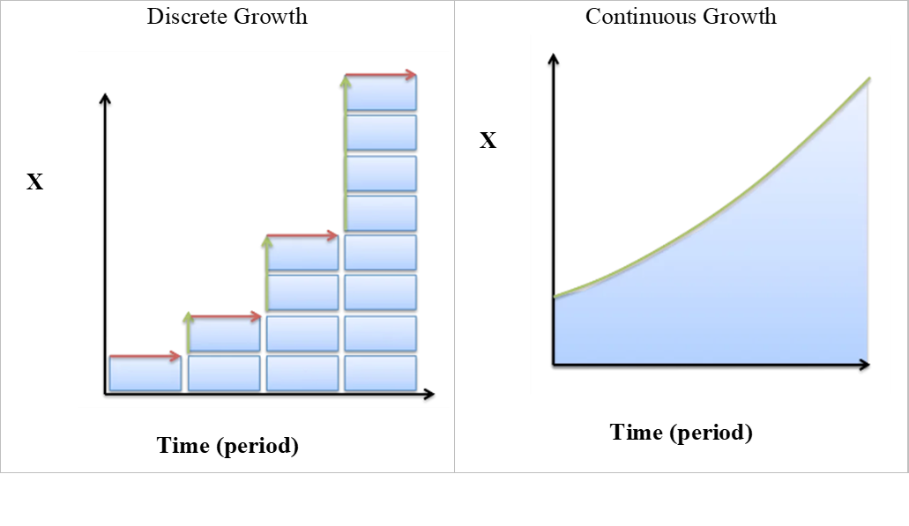
Discrete and continuous growth
Discrete Growth: This is the change that happens at specific time intervals such as; mating/pollination season, yearly interest rate, birth etc.
Continuous Growth: It is the change that happens at every instant (change can happen at any given point of time) such as; time, temperature, death, competition for resources, growth of an organism etc.
Follow the link below for more explanation on differentiating between discrete and continuous growth: https://www.youtube.com/watch?v=zupPMpcrLA8

Slide 4
INTEREST
Interest is the reward someone gets for lending out capital to another one for a given period. It is the cost of borrowing money, as in the case of interest charged on a loan balance.
Interest is usually expressed as a percentage. Interest can be calculated in two ways:
Simple interest is calculated on the principal (original amount) of a loan.
Compound interest is calculated on the principal amount and the accumulated interest of previous periods, and thus can be regarded as “interest on interest.”

Slide 5
Simple Interest
The formula for calculating simple interest is given by:​
Simple Interest (total amount payable after a given period) = P*I*N
where: P= Principal; I=Interest rate; N =Term of the loan/ Loan repayment period
For example, if simple interest is charged at 5% on a $10,000 loan that is taken out for three years, then the total amount of interest payable by the borrower is calculated as;
= $10,000 x 0.05 x 3
= $1,500.
Interest on this loan is payable at $500 annually, or $1,500 over the three-year loan term.

Slide 6
Compound Interest
The formula for calculating compound interest in a year is:
Compound Interest=[P(1+i)^{n}]−P OR; Compound Interest=P[(1+i)^{n} −1]
where:
P=Principal;
i=Interest rate in percentage terms;
n= number of compounding periods for a year
For example, if compound interest is charged at 5% on a $10,000 loan that is taken out for three years, then the total amount of interest payable by the borrower is calculated as;
= $10,000[(1+0.05)³−1]
= $10,000(1.157625−1)
= $1,576.25​

Slide 7
Illustration
Compound Interest=[P(1+i)^{n}] −P
Interest in 1st year = [10,000 (1+0.05)¹] − 10,000 = 500
Interest in 2st year = [10,500 (1+0.05)¹] − 10,500 = 525
Interest in 3nd year = [11,025 (1+0.05)¹] − 11,025 = 551.25
Total Interest at the end of the third year = (500 +525 +551.25) = 1,576.25
This is to say (ie the amount of principal and interest paid on a yearly basis);
Year | Opening Balance (P) | Interest at 5% (I) | Closing Balance (P+I)
1 | $10,000.00 | $500.00 | $10,500.00 (10,000+500)
2 | $10,500.00 | $525.00 | $11,025.00 (10,500 +525)
3 | $11,025.00 | $551.25 | $11,576.25 (11,025+ 551.25)
Total Interest |  | $1,576.25

Slide 8
Exercise
A certain bank in town offers an interest rate of 4.2% per annum on its deposit accounts. Find the accumulation of £5000 after seven years in this account.
How long will it take a principal amount of £900 to increase to £1000 under an interest rate of 3% per annum?

Slide 9
INVESTMENT APPRAISAL TECHNIQUES
Investment Appraisal is the analysis done to ascertain the profitability and viability of a business before investing in it.
Potential investors use several techniques to conduct investment analysis as discussed below.

Slide 10
The Annual Equivalent Rate (AER)
The Annual Equivalent Rate is the interest rate for a saving account or investment product/asset that has more than one compounding period.
The compounding period (duration taken for interest to be added on your savings/financial investment) could be weekly, monthly, half/semi annual or yearly.
The AER shows how much you could earn from a savings account over a year.
It is used to make comparisons between different saving accounts and financial assets (such as; stocks, unit trusts, bonds, treasury bills, and mutual funds) to make appropriate saving/ investment decisions.
The AER is captured as a percentage (%).

Slide 11

Example of a Financial Asset

Slide 12
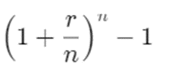
The Annual Equivalent Rate (AER) –Ct’d
The AER can be computed using the following Formula;
AER =
Where;
n is the number of compounding periods
r is the stated interest rate.
Reference: https://www.investopedia.com/terms/a/aer.asp

Slide 13
Example
Assume an investor wishes to sell all the securities in their investment portfolio and place all the proceeds in a savings account. The investor is deciding between placing the proceeds in Bank A, Bank B, or Bank C, depending on the highest rate offered.
Bank A has a quoted interest rate of 3.7% that pays interest on an annual basis. Bank B has a quoted interest rate of 3.65% that pays interest quarterly, and Bank C has a quoted interest rate of 3.7% that pays interest semi-annually.
In which bank should the investor save?

Slide 14
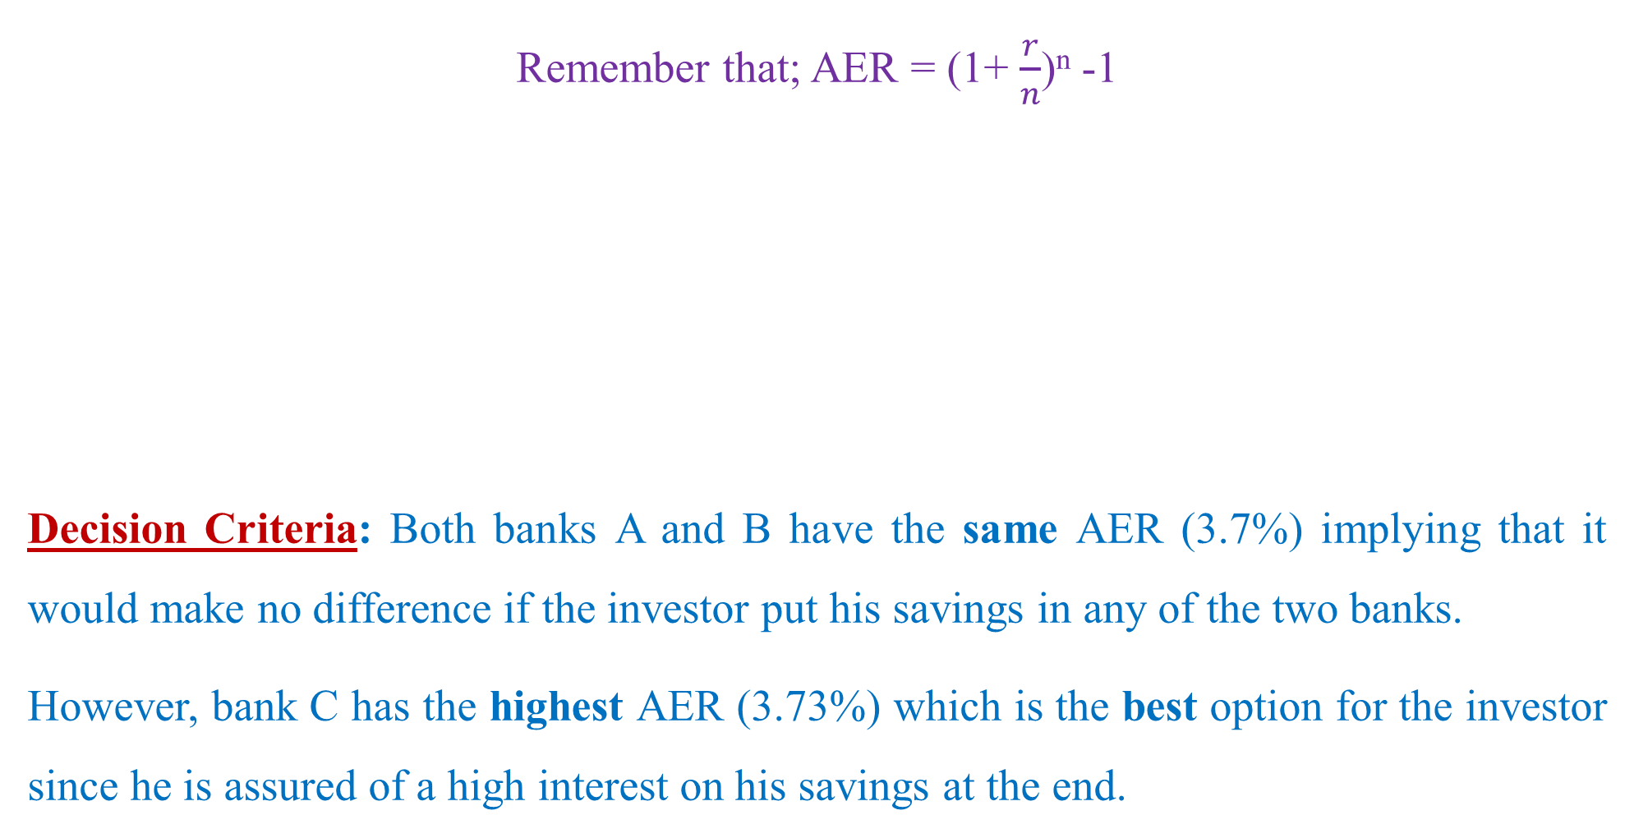
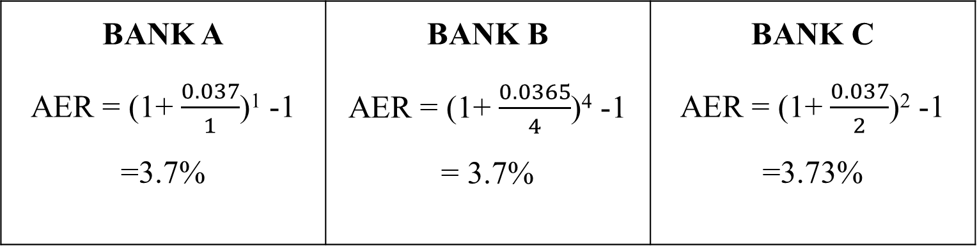
Solution
Remember that; AER = (1+ $\frac{r}{n}$)^{n} -1
Decision Criteria: Both banks A and B have the same AER (3.7%) implying that it would make no difference if the investor put his savings in any of the two banks.
However, bank C has the highest AER (3.73%) which is the best option for the investor since he is assured of a high interest on his savings at the end.
BANK A AER = (1+ $\frac{0.037}{1}$)¹ -1 =3.7% | BANK B AER = (1+ $\frac{0.0365}{4}$)⁴ -1 = 3.7% | BANK C AER = (1+ $\frac{0.037}{2}$)² -1 =3.73%

Slide 15
Exercise
An investment in bond A pays 5% interest compounded monthly while bond B pays 10% compounded semi-annually. Which bond should the investor opt for and why?

Slide 16
NET PRESENT VALUE (NPV)
NPV is one of the methods or techniques used to evaluate or appraise individual projects or groups of projects with the aim of selecting the best one to invest in.
It helps managers to decide on which investment(s) to undertake or not to undertake. In short, it helps to know which investment is viable/worthwhile.
This method of investment appraisal takes into account the time value for money.
NPV is the difference between the value of the initial cash outlay on a project and the present value of future cash flow associated with the project.

Slide 17
Methodology of NPV
It involves the following steps:
Determine the initial investment
Determine the Net cash inflows (the difference between benefits and costs)
Determine the cost of capital which is normally the discount factor
Discount the net cash inflows
Add the discounted net cash inflows
Subtracts the initial investment (1) from (5), to get NPV

Slide 18
Methodology of NPV (Ct’d)
NOTE: Discounting a future cash flow means taking into consideration the cost of capital and the risk involved. For example; If you invest money in a given enterprise, you forego interest which you would have earned if you deposited that money on a fixed deposit account.
The opposite of discounting is compounding. The NPV method simply discounts all future cash flows (both outflows and inflows), at a chosen discount rate to their present value

Slide 19
NPV Decision Rule
Positive NPV: This implies the investment benefits outweigh the investment costs- i.e the investment increases owner’s wealth. Thus, accept the project
Negative NPV: This implies Investment reduces shareholder’s wealth. Therefore, the investor should reject the project
Zero NPV: Investment neither increases nor decreases owner’s wealth; Thus, the investor should be indifferent between accepting and rejecting the project.
NOTE: If you have to choose between two projects with positive NPV, take the one with greater NPV.

Slide 20
Example
Given two projects two projects A (Rearing rabbits) and B (rearing goats). Determine the NPV and advise the farmer on which project to undertake using a discount factor (cost of capital) of 10%.
Project | A (in $) | B (in $)
Initial investment | 250 | 350
Year | Net cash inflows
1 | 80 | 110
2 | 100 | 120
3 | 70 | 120
4 | 100 | 120
5 | 100 | 120

Slide 21
Solution
PV= Net Cash Inflow *Discount Factor
Present value of $1 to be received after t years = 1/(1+r)^{t} ; where r is the interest rate and t is the period. This can as well be computed from the Present Value Tables.
PROJECT A |  |  |  | PROJECT B
Year | Net cash inflow | DF (10%) | PV | Year | Net cash inflows | D.F (10%) | PV
0 | (250) |  |  | 0 | (350)
1 | 80 | 0.909 | 72.72 | 1 | 110 | 0.909 | 99.99
2 | 100 | 0.826 | 82.6 | 2 | 120 | 0.826 | 99.12
3 | 70 | 0.751 | 52.57 | 3 | 120 | 0.751 | 90.12
4 | 100 | 0.683 | 68.3 | 4 | 120 | 0.683 | 81.96
5 | 100 | 0.621 | 62.1 | 5 | 120 | 0.621 | 74.52
Total |  |  | 338.29 | Total |  |  | 445.71
NPV(A) = TPV-Initial investment = 338.29 -250 = 88.29 |  |  |  | NPV(B) =TPV-Initial investment =445.71 - 350 =95.71
Selection Criteria
Project B is selected because its NPV is greater than NPV of project A.
Follow the link below for more explanation on how to compute NPV:
https://www.youtube.com/watch?v=TU4RNBK9j3k

Slide 22

Thank you
@ASK

